Slide 1
Anniston Army Depot (Southeast Industrial Area)
National Priorities List(NPL) site

Slide 2
Introduction
Anniston Army depot occupies 15,319 acres of land.
It is an active U.S Army installation site located in Calhoun County, Alabama, 10 miles west of Anniston.
It provides munitions storage and refurbishment, testing and decommissioning of combat vehicles and various types of ordnances.

Slide 3
Topics of discussion
Reason for listing on the NPL
Contaminants present on site
Cleanup activities
Current site status
Activity and use limitations
Sampling and monitoring

Slide 4
Reason For Listing On The NPL
Soil and underground contamination caused by onsite disposal of industrial chemicals during the 1950 through 1981 time periods.
Presence of contaminants of concern(COCs) on site that pose threat to human health and the environment.
Notes:
The Environmental Protection agency place a portion of Anniston Army Depot on the Superfund program's National Priorities list in 1989 (The United States Environmental Protection Agency, n.d.).

Slide 5
Contaminants Present On Site
Volatile Organic Compounds (VOCs).
Metals.
Explosives
Notes:
VOCs are the most often released from cleaning materials used to degrease and clean heavy equipment (The United States Environmental Protection Agency, n.d.).
The heavy equipment stored on base leach the metals.
Explosives are due to the nature of the Base. The Base is an ammunition depot thus the explosives.
Also the treatment of VOCs or explosives in groundwater can further cause the release of naturally occurring metals from soils in the ground (The United States Environmental Protection Agency, n.d.).

Slide 6
Criteria to identify COCs by EPA
Environmental Protection Agency (EPA) uses three approaches to identify Contaminants on Site.
The first is by identifying people or ecological resources that could be exposed to contamination found on site(The United States Environmental Protection Agency, n.d.).
Second is determining the type and amount of contaminants on site.
Third is by determining any human health or ecological impact that could arise from contact with the contaminants.

Slide 7
Cleanup Activities
With an oversight provided by EPA and the Alabama Department of Environmental Management (ADEM), the army leads the investigation and clean up activities.
The activities include capturing and treating contaminated groundwater.
Resource Conservation and Recovery Act (RCRA)-and Superfund related actions.
Installation of five-air stripping towers.
Emergency response for off-site groundwater contamination.
Notes:
Over the years, the Army has started RCRA-and Superfund related actions that have addressed contamination and disposal issues at the depot (The United States Environmental Protection Agency, n.d.).
There actions have included treating groundwater contamination; removing and disposing of contaminated soil, treating contaminated soil on site, covering soils as need, and emergency response planning for off-site groundwater contamination.

Slide 8
Capturing and treating contaminated water
Use of an upgraded on-site groundwater interception system and an-air striping treatment system at the Krebs Water Treatment Plant(The United States Environmental Protection Agency, n.d.).
Addressing the contaminated fractured bedrock.
Use of specialized technologies in areas that are source of dense non-aqueous phase liquid at OU1.
Removal of additional source material for success of groundwater remediation.
Notes:
The Army continuous to capture and treat contaminated groundwater using an on-site groundwater interception system and air-stripping treatment system at the Krebs Water treatment Plant.
The Army has a plan to use specialized technologies to treat areas where it has identified sources of dense non-aqueous phase liquid at OU1.
At OU3 the Army has determined that additional source materials needs to be removed to enable groundwater remediation to succeed (The United States Environmental Protection Agency, n.d.).
There is a continuous investigation for contamination in soils and groundwater at 0U4 and OU5 by the Army.

Slide 9
RCRA-and Superfund related actions
Treating groundwater contamination.
Removing and disposing contaminated soil.
Treating contaminated soil on-site.
Covering of soil as needed.

Slide 10
Superfund cleanup process
Preliminary assessment.
National Priorities List (NPL).
Remedial investigation.
Records of decision (ROD).
Remedial design..
Construction completion.
Notes:
Preliminary assessment includes site visitation and evaluation of potential for release of hazardous substance.
The NPL is primarily an information resource that identifies sites that warrant cleanup (The United States Environmental Protection Agency, n.d). The list includes sites that have the most hazardous wastes as identified by Superfund.
Remedial investigation involves evaluation of the nature and extent of contamination at site and assessing potential threats.
ROD explains which cleanup progress will be used at NPL site.
Remedial design involves compiling of cleanup detailed plans. It also includes development of engineering drawings and specifications for a site cleanup. It follows design and includes the actual construction or implementation phases of site cleanup (The United States Environmental Protection Agency, n.d).
When the construction is complete gives a cleanup milestone for NPL sites, specifically that physical cleanup activities at site have been completed.

Slide 11
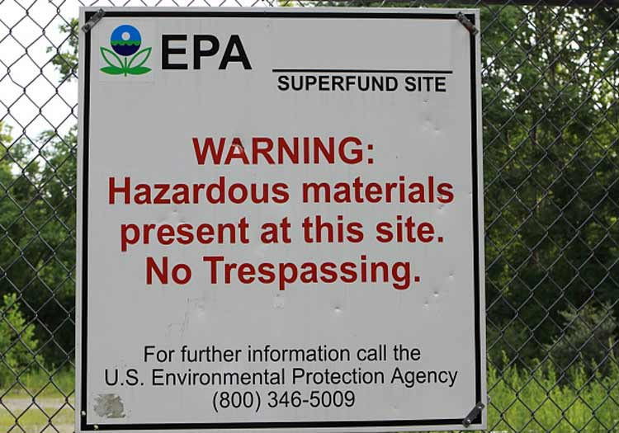
Warning sign on NPL site

Slide 12
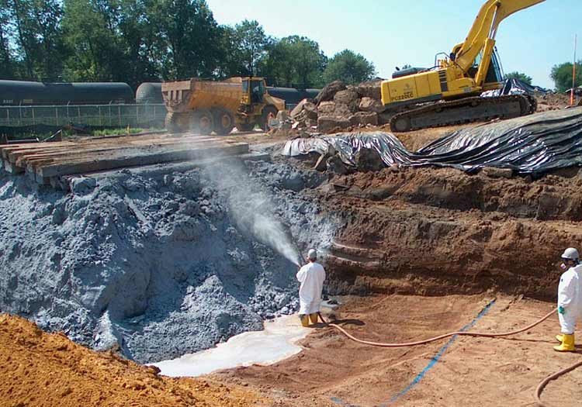
Soil excavation and cleanup at a Superfund site

Slide 13
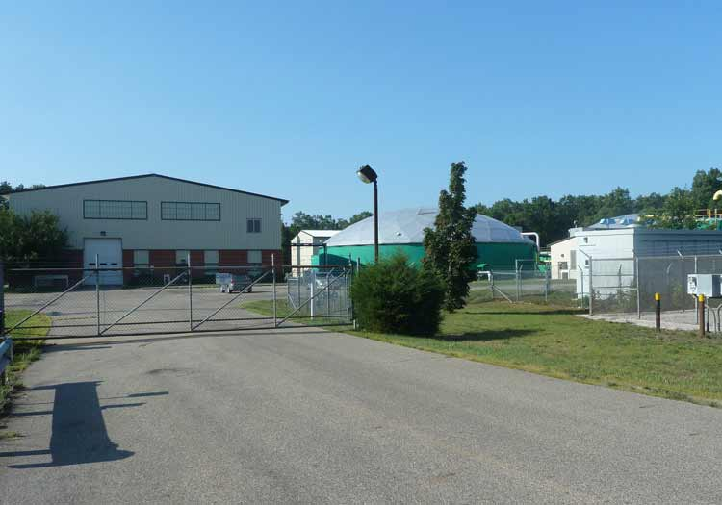
Station after completed cleanup

Slide 14
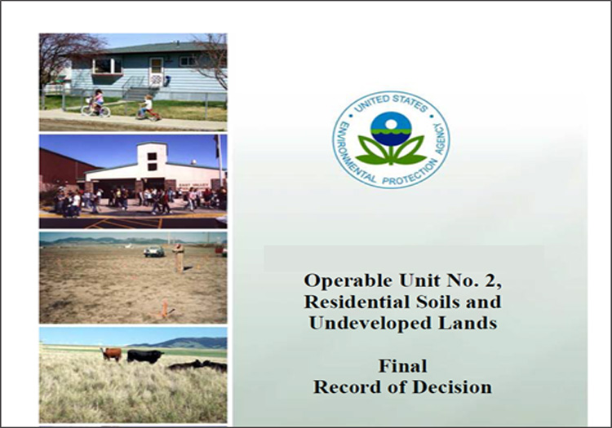
Final Record of Decision

Slide 15
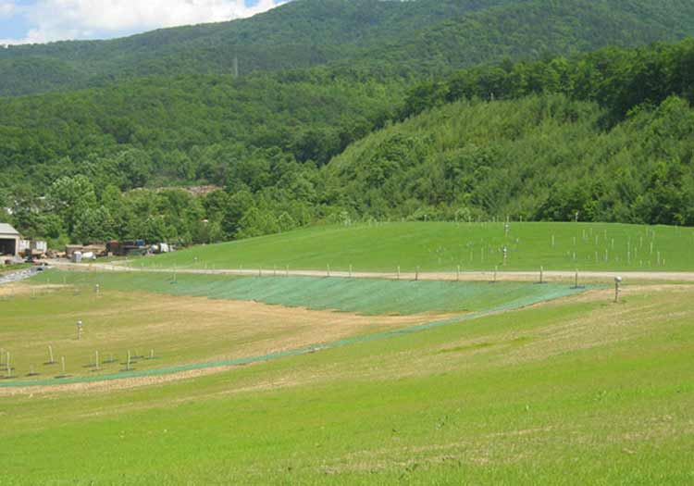
Reseeded landfill cap

Slide 16
Installation of five air-stripping towers
Collaboration of Army and local municipal water supply to install the five air-stripping towers.
Operators use the towers to remove volcanic organic component (VOC) in groundwater.
Treating of water in Coldwater Spring by the plant operators before supplying it to the public.
Notes:
In collaboration of the Army and the local municipal water supply, the Army was responsible for paying for the construction of the towers, while the municipal water supply chose to pay for the operations of the towers,.
The water supplied to the public, is now treated and does not contain any harmful levels of VOCs.

Slide 17
Emergency response and removal
Drafting of a plan by the Army to remove Building 172 in OU3.
The Building in OU3 is believed to be a continuous and major source of explosive contamination in groundwater.
The objective of removing the building is to decontaminate building materials and dispose them appropriately.
Notes:
The objective of removing the building is to decontaminate building materials and dispose them appropriately.
Also there will be removal of contaminated soil.

Slide 18
Current Site Status
The Army and EPA is continuing ground water treatment while also evaluating alternative ground water treatment approaches.
The fourth Five Year Review was completed in September 2015 by EPA.
The next review is set for September 2020.
Notes:
Investigations and cleanup activities have focused on five Ares, which EPA refers to as operable units, or OU.
The distinct areas at the site are OU, SIA groundwater, OU, Southeast Industrial Area (SIA) soil, OU-3, Ammunition Storage Area, OU-4, Military Munitions Response Program, and OU-5, Western Industrial Area.

Slide 19
Activity And Use Limitation
The EPA refers to activity and use limitations on site as institutional controls.
By limiting land use, institutional controls reduce exposure to contamination.
Institutional controls also act as a guide to human behavior.
Example of controlled human behavior is preventing land uses such as residential uses that are not doing the clean up on a regular basis.
Notes:
Institutional controls play an important role n site remedies because they reduce exposure to contamination by limiting land or resource use (The United States Environmental Program, n.d).

Slide 20
Land Use Controls (LUCs)
LUCs prohibits;
Use of groundwater for drinking or irrigation purposes
Calls for fencing of the Depot and associated signage
Requires notifications of private well owners as a reminder to not use or drink ground water
Requires maintenance and monitoring of remedial systems as well as the use restrictions.
Notes:
The Depot is expected to implement these LUCs into their management systems and inspect and report on the implementation and success of the LUCs in an annually basis.

Slide 21
Sampling and Monitoring
A task force which is working with an objective of protecting wildlife.
The army is protecting the Pygmy Sculpin fish native to Alabama and it only lives in the Coldwater Spring area.
The task force is made up of representatives from the U.S Army Corps of Engineers, ADEM, the State of Alabama’s Fish and Wildlife, the U.S Fish and Wildlife Service and EPA.
Notes:
The Army continuous to monitor groundwater at each OU to ensure remedies are effective.

Slide 22
Reference
The United States Environmental Protection Agency. Anniston Army Depot (Southeast Industrial Area).

